Slide 1
Identifying Bridges in Graphs: A Persistent Homology Approach
M. Skilleter

Slide 2

The Problem
We model a social network as a graph $X=\left(V,E,μ\right)$ with $V$ the vertex set, $E$ the edge set and $μ:V∪E→ℝ_{≥0}∪\{∞\}$ a weight function.

Slide 3

The Problem
We model a social network as a graph $X=\left(V,E,μ\right)$ with $V$ the vertex set, $E$ the edge set and $μ:V∪E→ℝ_{≥0}∪\{∞\}$ a weight function.
Communities in the network correspond to clusters in the graph.

Slide 4

The Problem
We model a social network as a graph $X=\left(V,E,μ\right)$ with $V$ the vertex set, $E$ the edge set and $μ:V∪E→ℝ_{≥0}∪\{∞\}$ a weight function.
Communities in the network correspond to clusters in the graph.
We thus want to identify vertices which don’t belong to any cluster: the bridges.

Slide 5

Early Definitions and Assumption
We may assume $X$ is connected by applying the algorithm to each path-component in parallel.

Slide 6
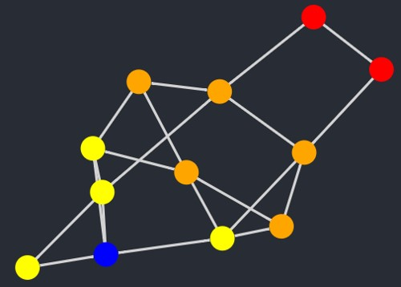

Early Definitions and Assumption
We may assume $X$ is connected by applying the algorithm to each path-component in parallel.
For every vertex $v$, we have an associated shortest path filtration of $X$. Figure 1 is an example of this filtration, with $v$ the blue vertex and the intensity increasing as we radiate out from $v$.
Figure 1: Example of shortest path filtration

Slide 7
Persistence Barcodes and the Wasserstein Distance
Using the shortest path filtration, the 1-dimensional persistence barcode is the only non-trivial one.

Slide 8

Persistence Barcodes and the Wasserstein Distance
Using the shortest path filtration, the 1-dimensional persistence barcode is the only non-trivial one.
The $p,q$ Wasserstein distance between two barcodes $A$ and $B$is given by
$$W_{p,q}\left(A,B\right)=\inf_{\begin{aligned}η:A→B \\ a bijection\end{aligned}}{{\left(\sum_{a∈A}{{\left\|a−η\left(a\right)\right\|}_{q}^{p}}\right)}^{1/p}}$$

Slide 9
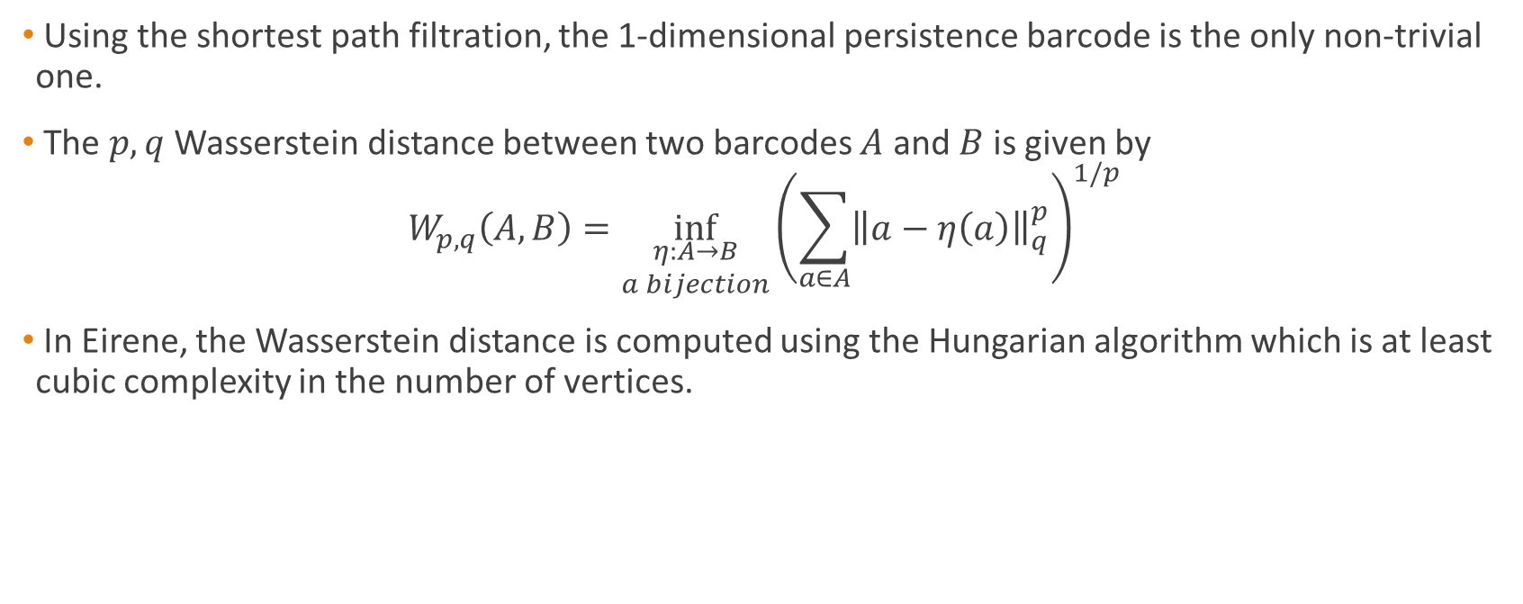
Persistence Barcodes and the Wasserstein Distance
Using the shortest path filtration, the 1-dimensional persistence barcode is the only non-trivial one.
The $p,q$ Wasserstein distance between two barcodes $A$ and $B$is given by
$$W_{p,q}\left(A,B\right)=\inf_{\begin{aligned}η:A→B \\ a bijection\end{aligned}}{{\left(\sum_{a∈A}{{\left\|a−η\left(a\right)\right\|}_{q}^{p}}\right)}^{1/p}}$$
In Eirene, the Wasserstein distance is computed using the Hungarian algorithm which is at least cubic complexity in the number of vertices.

Slide 10

Advantages of the Shortest Path Filtration
The shortest path filtration lets us associate a 1-dimensional persistence barcode to every vertex. These can be modelled as $l×2$ matrices where $l$ is the total number of $1$-cycles in $X$.

Slide 11
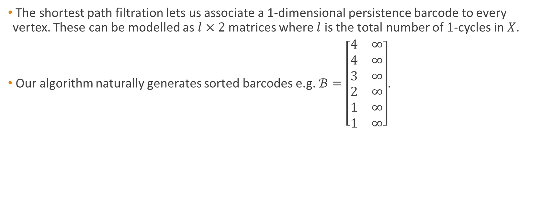
Advantages of the Shortest Path Filtration
The shortest path filtration lets us associate a 1-dimensional persistence barcode to every vertex. These can be modelled as $l×2$ matrices where $l$ is the total number of $1$-cycles in $X$.
Our algorithm naturally generates sorted barcodes e.g. $ℬ=\left[\begin{matrix}4 & ∞ \\ 4 & ∞ \\ 3 & ∞ \\ 2 & ∞ \\ 1 & ∞ \\ 1 & ∞\end{matrix}\right]$.

Slide 12
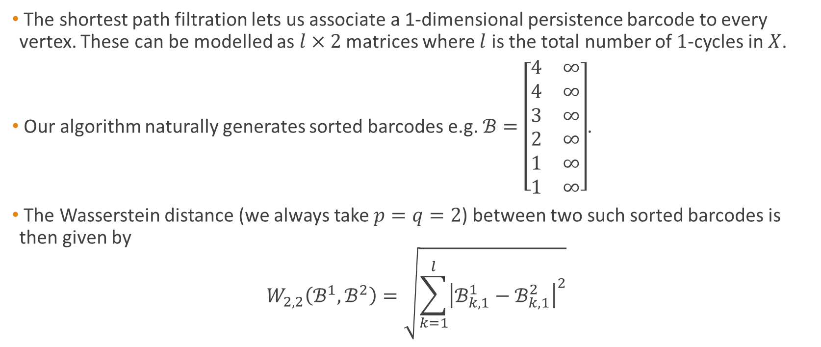
Advantages of the Shortest Path Filtration
The shortest path filtration lets us associate a 1-dimensional persistence barcode to every vertex. These can be modelled as $l×2$ matrices where $l$ is the total number of $1$-cycles in $X$.
Our algorithm naturally generates sorted barcodes e.g. $ℬ=\left[\begin{matrix}4 & ∞ \\ 4 & ∞ \\ 3 & ∞ \\ 2 & ∞ \\ 1 & ∞ \\ 1 & ∞\end{matrix}\right]$.
The Wasserstein distance (we always take $p=q=2$) between two such sorted barcodes is then given by
$$W_{2,2}\left(ℬ^{1},ℬ^{2}\right)=\sqrt{\sum_{k=1}^{l}{{\left|ℬ_{k,1}^{1}−ℬ_{k,1}^{2}\right|}^{2}}}$$

Slide 13
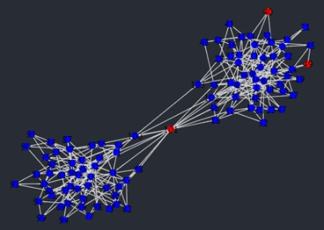
Refining the Search
Figure 2 is an example graph generated using more classical clustering methods.
Figure 2: Example graph clustered using the annulus test.

Slide 14
Refining the Search
Figure 2 is an example graph generated using more classical clustering methods.
Using the Wasserstein distance, the vertices in the upper right-hand corner can be said to be “close enough” to neighbouring cluster points to also be part of the cluster.
Figure 2: Example graph clustered using the annulus test.

Slide 15
Refining the Search
Figure 2 is an example graph generated using more classical clustering methods.
Using the Wasserstein distance, the vertices in the upper right-hand corner can be said to be “close enough” to neighbouring cluster points to also be part of the cluster.
Figure 2: Example graph clustered using the annulus test.

Slide 16
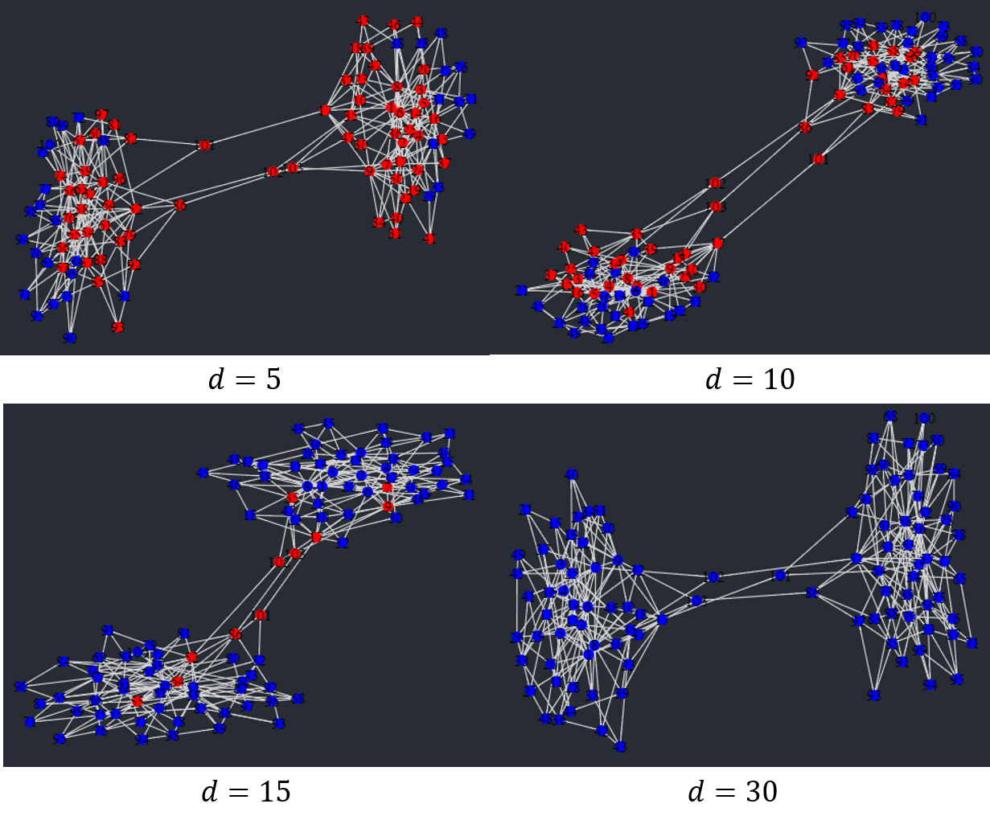

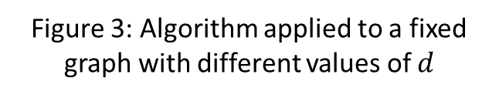
An Upper Bound of Wasserstein Distance
The value of $d$, the upper bound on the Wasserstein distance between two cluster points, greatly affects the accuracy of the algorithm. Figure 3 is an example of this.
Choosing the value of $d$ is a problem that we are still investigating.
Figure 3: Algorithm applied to a fixed graph with different values of $d$

Slide 17
Solving an Extremal Problem
We count the number of 1-cycles born at each stage of the filtration. Intuitively, a cluster point should have a large portion of 1-cycles born early in the filtration while there should be an initial delay for a bridge.

Slide 18
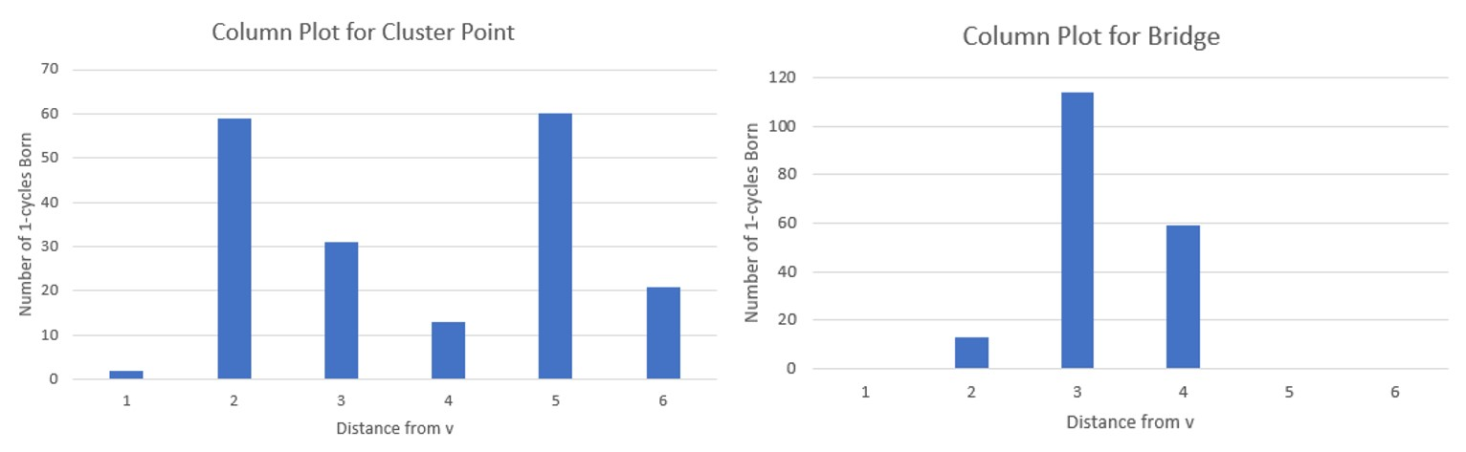
Solving an Extremal Problem
We count the number of 1-cycles born at each stage of the filtration. Intuitively, a cluster point should have a large portion of 1-cycles born early in the filtration while there should be an initial delay for a bridge.
Figure 4: Column plots showing number of 1-cycles born at each stage of the shortest path filtration

Slide 19
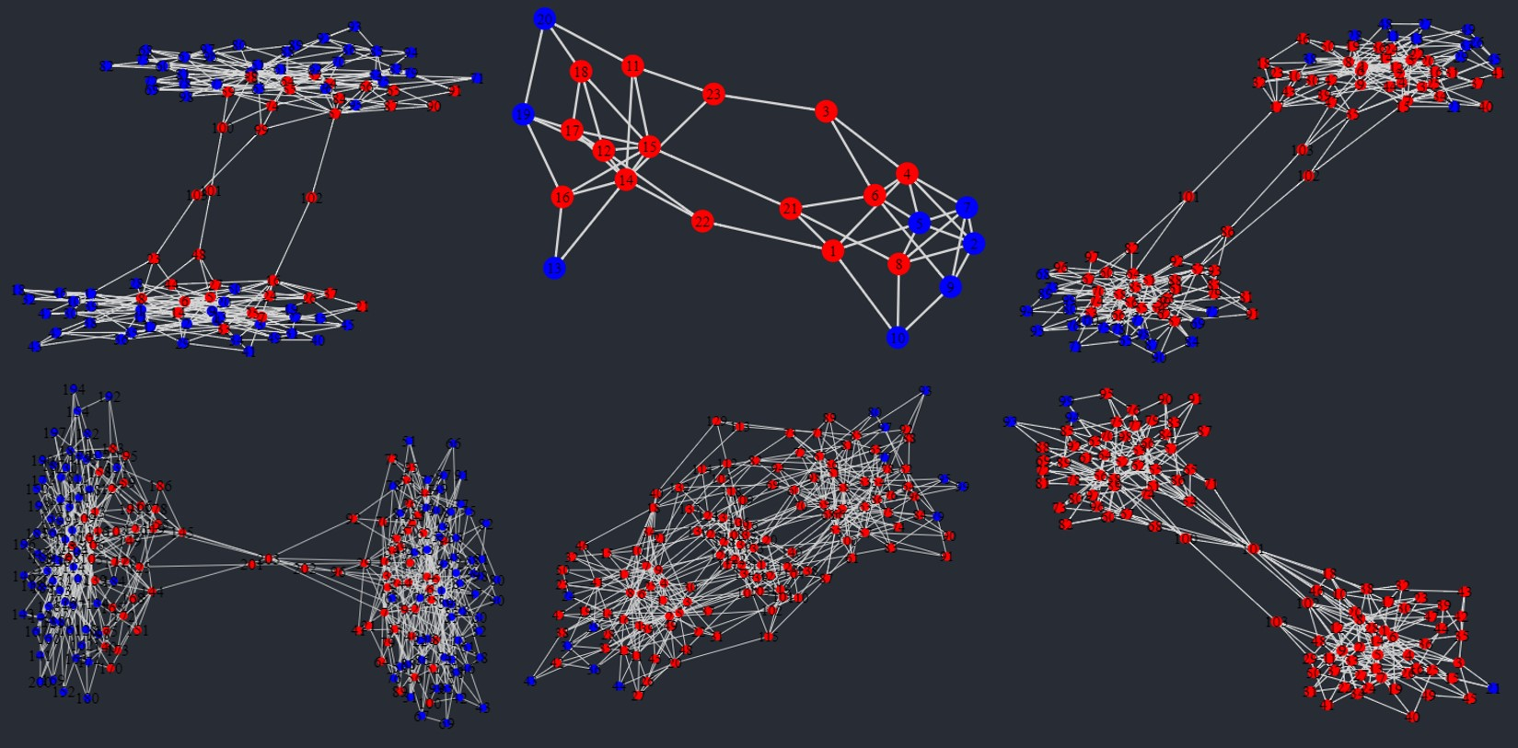
Solving an Extremal Problem
Figure 5: Initial cluster points using the 1-cycle birth times test

Slide 20
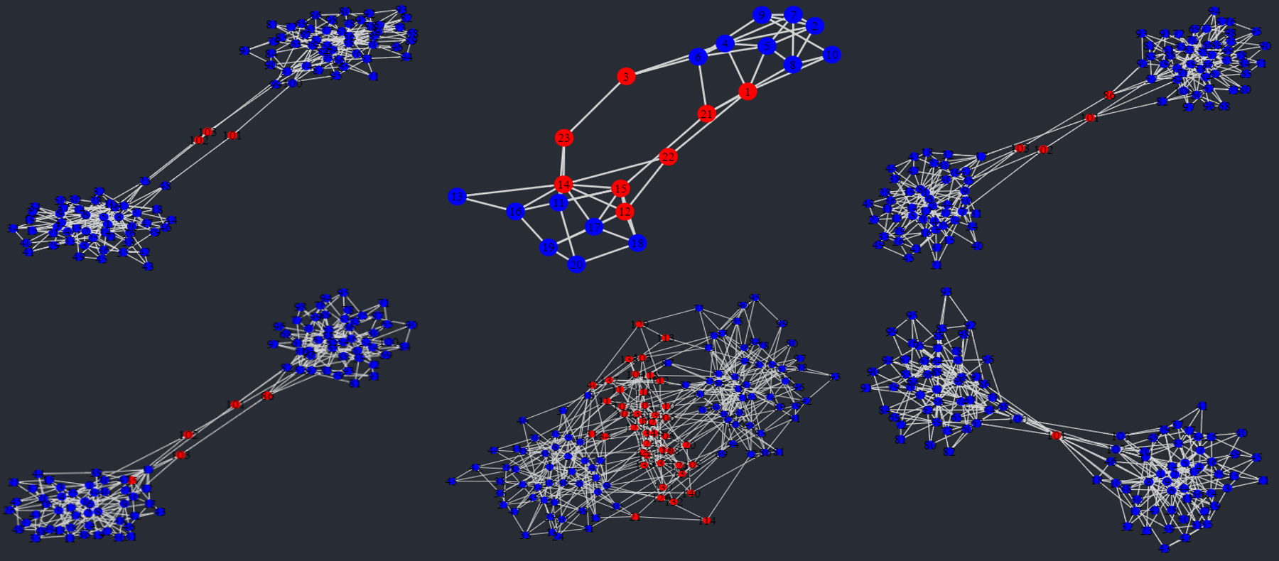
The Algorithm Applied

Slide 21
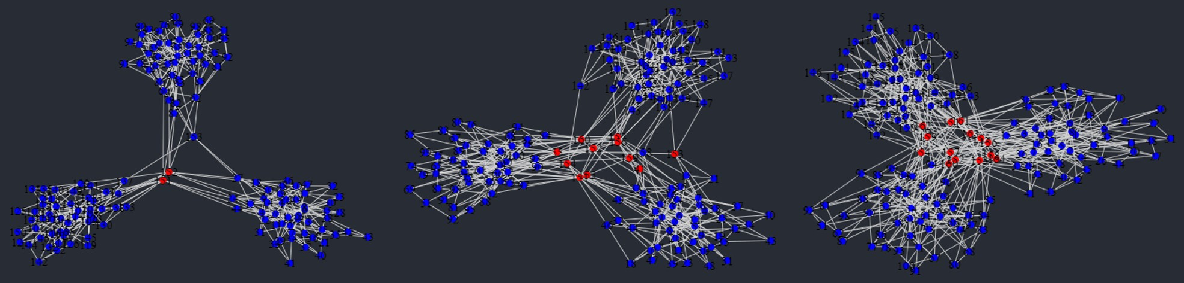
The Algorithm Applied

Slide 22
References
A. Hatcher (2002). Algebraic Topology. Cambridge University Press. Available at https://pi.math.cornell.edu/~hatcher/AT/AT.pdf
M. Kerber, D. Morozov, A. Nigmetov (2016). Geometry Helps to Compare Persistence Diagrams. Available at https://arxiv.org/abs/1606.03357
B. Slininger. Fiedler's Theory of Spectral Graph Partitioning. Available at http://citeseerx.ist.psu.edu/viewdoc/download?doi=10.1.1.592.1730\&rep=rep1\&type=pdf
D. Spivak (2009). Higher-dimensional models of networks. Available at https://arxiv.org/abs/0909.4314
S. Bhatia, B. Chatterjee, D. Nathani, M. Kaul (2018). Understanding and Predicting Links in Graphs: A Persistent Homology Perspective. Available at https://arxiv.org/abs/1811.04049
D. Yan, L. Huang, M. Jordan. Fast Approximate Spectral Clustering. Available at https://people.eecs.berkeley.edu/~jordan/papers/yan-etal-long.pdf
D. Centola, M. Macy. Complex contagions and the weakness of long ties. In: American Journal of Sociology 113.3 (2007), pp. 702-734.
R. Ram, M. Rizoiu (2019). A social science-grounded approach for quantifying online social influence. In: Australian Social Network Analysis Conference (ASNAC'19) (p. 2). Adelaide, Australia.

